Slide 1

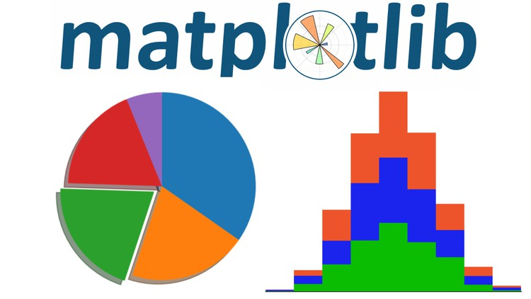
Data Science Tools, Part 2: Pandas, Matplotlib
Notes:
<Notes>

Slide 2

Pre-Quiz: How much do you already know about Pandas?
What is python pandas?
How is a pandas DataFrame different than a NumPy array?
Name three unique operations (i.e., methods) you can do with pandas?
How do you read from or write to a csv file using pandas?
Keep this Quiz and see if you can fill-in any missing questions during the discussion today

Slide 3
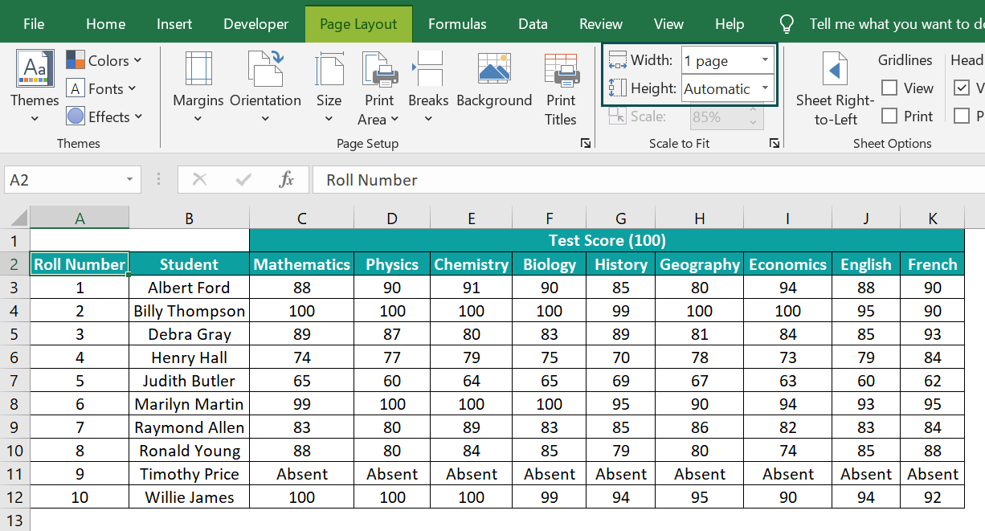
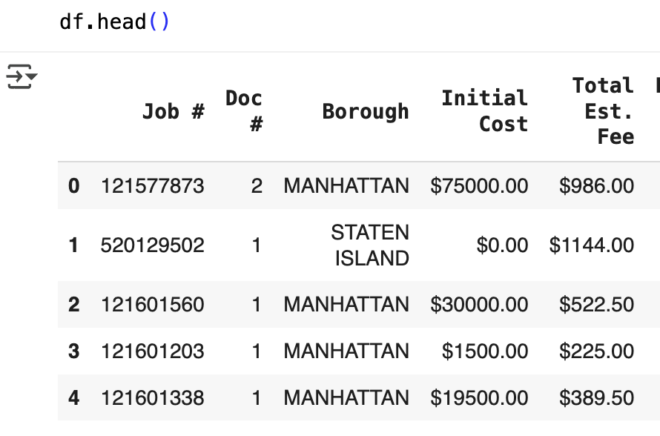
What is Pandas?
Think of pandas as Excel for Python.
If you’ve ever used Excel or Google Sheets — adding columns, filtering rows, making summaries — pandas does the same, but with code.
Notes:
Python pandas is an open-source data analysis and manipulation library. It’s built on top of NumPy and provides fast, flexible, and expressive tools for working with structured data.
Here’s what makes pandas useful:
Data structures:
Series → a one-dimensional labeled array (like a column in Excel).
DataFrame → a two-dimensional labeled table (like a spreadsheet or SQL table).
Core capabilities:
Reading and writing data from multiple formats (CSV, Excel, SQL, JSON, Parquet, etc.).
Data cleaning (handling missing values, duplicates, type conversion).
Data transformation (filtering, grouping, merging, joining).
Statistical and time-series analysis.
Easy integration with visualization libraries (like Matplotlib or Seaborn).

Slide 4
Pandas Definition
Open-Source software library written for Python
Pandas derived from the term “panel data” from econometrics
Data structures and operations for manipulating numerical tables and time series
DataFrame is a 2-Dimensional structure built as a combination of Series arrays with a shared index
Built on NumPy
Originally released 11 Jan 2008. The current stable release is version 2.3.2, released August 21, 2025.
https://en.wikipedia.org/wiki/Pandas_(software)

Slide 5
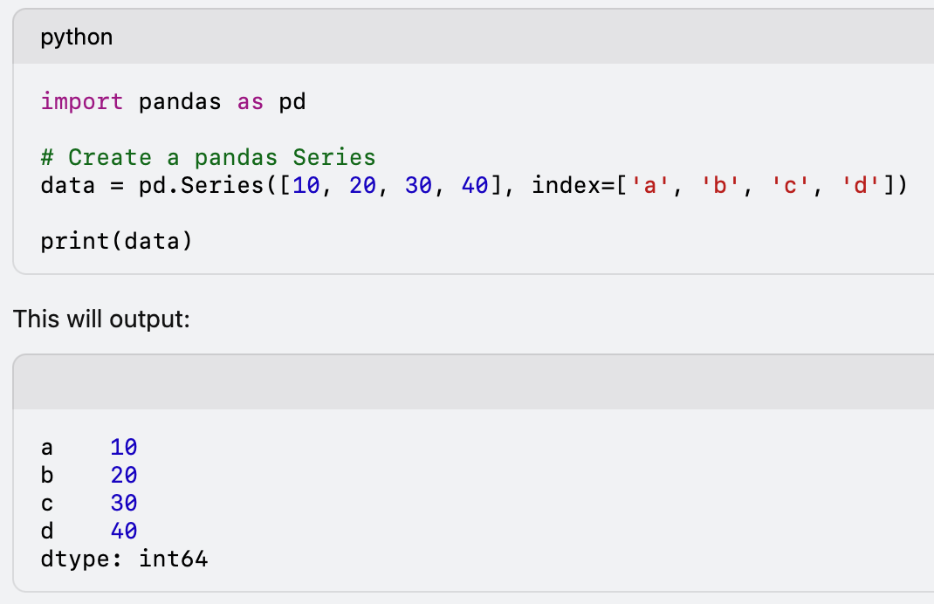
Pandas Series
A pandas Series is a one-dimensional labeled array, capable of holding data of any type (integers, floats, strings, Python objects, etc.).
Key features of a pandas Series:
• Indexing: Each element in the Series has a corresponding index, which allows for easy access and manipulation of data. Default is numeric indexing.
• Homogeneous: The Series can hold elements of the same type (though mixed types are possible, but uncommon and not recommended practice).

Slide 6
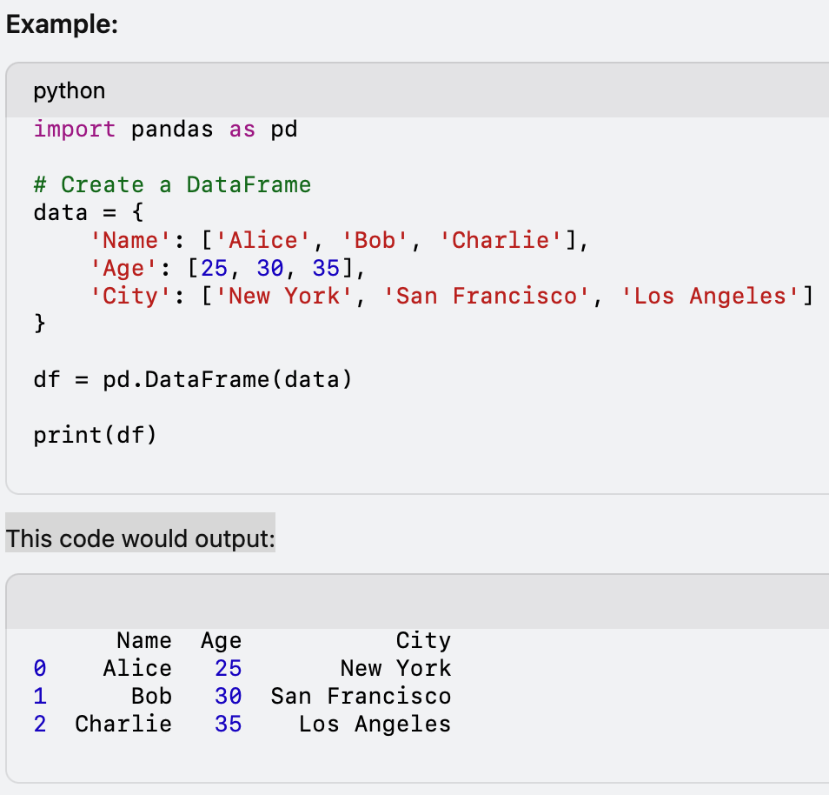
Pandas Dataframe
Defined as multiple Series objects that share an index
A Pandas DataFrame is a two-dimensional, labeled data structure in Python, similar to a table or spreadsheet, that stores data in rows and columns. Each column in a DataFrame can have a different data type (e.g., integers, floats, strings, etc.).
Key features of a DataFrame:
Rows and Columns: Like a table, with rows representing individual records and columns representing variables or features.
Labels: Rows and columns can have labels (names), making it easy to access, slice, or manipulate data. Index and Column for row/column labels
Data Handling: It can handle missing data and supports arithmetic operations, data filtering, aggregation, and transformation.
Data Input/Output: Can read and write data from various file formats (e.g., CSV, Excel, SQL, etc.).

Slide 7
Subsetting Data
Subsetting data involves choosing specific rows and columns from a dataframe according to labels, indices, and slices.
A single column can be selected by using the label of the desired column. Ex: Using the country dataset assigned to the variable country, the Population column can be selected using the country['Population'] or country.Population. Multiple columns can also be selected by using an array of strings. Ex: country[['Name', 'Population']]
The iloc(x,y) method for a dataframe is used to select an individual element using an index location, where x is the row and y is the column. Ex: country.iloc[0,1] returns the element in row 0 and column 1. The colon character : is used in slice notation to select multiple rows or columns. Ex: country.iloc[:5,1:3] returns rows before row 5 and columns 1 thru 2.
The loc(x,y) method can also be used to subset data, but y, in this case, is an array of column labels, instead of an integer or a range of integers. Ex: Both country.iloc[:7,1:3] and country.loc[:6,['Continent','Population']] give the same results.

Slide 8
Conditional Filtering
Comparison and logical operators can be used to subset data. When these operators are used, only rows for which the expression is true will be returned. Ex: country[country['Population'] > 100000] will display rows whose 'Population' column values are greater than 100,000.

Slide 9
Missing Values
There are several methods to deal with missing values in the data frame:
df.method() | description
dropna() | Drop missing observations
dropna(how='all') | Drop observations where all cells is NA
dropna(axis=1, how='all') | Drop column if all the values are missing
dropna(thresh = 5) | Drop rows that contain less than 5 non-missing values
fillna(0) | Replace missing values with zeros
isnull() | returns True if the value is missing
notnull() | Returns True for non-missing values

Slide 10
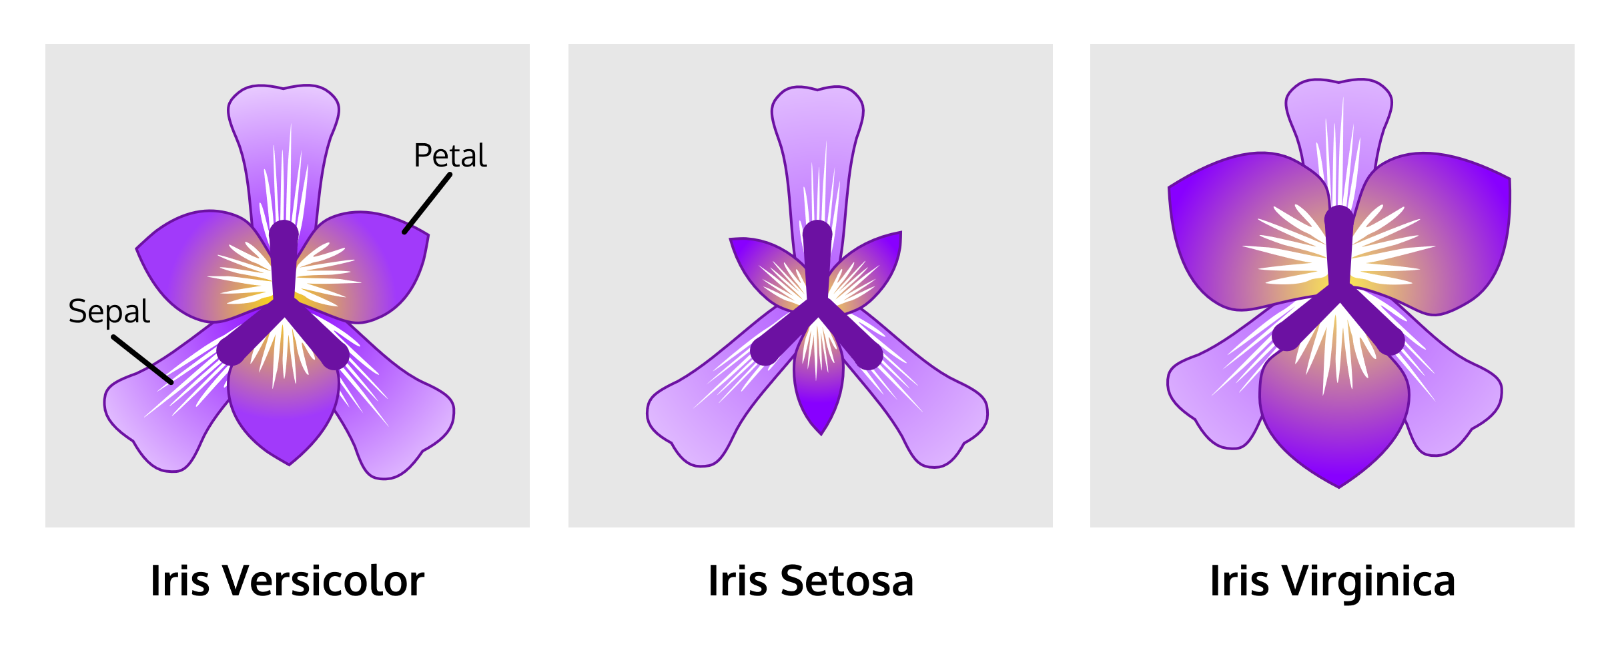
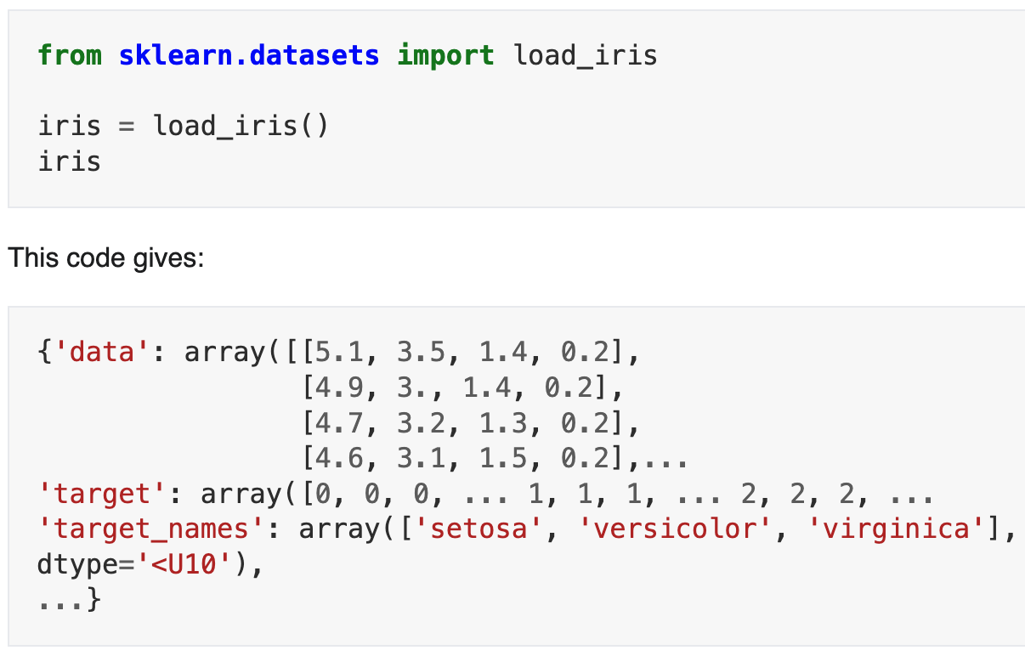
Iris Flower Data Set
The Iris flower data set was made famous by the British statistician and biologist Ronald Fisher in 1936.
It is sometimes called Anderson’s Iris data set because Edgar Anderson collected the data to quantify the morphologic variation of Iris flowers of three related species.
The dataset contains a set of 150 records with five attributes: sepal length, sepal width, petal length, petal width and species.
The iris data set is widely used for teaching machine learning. The dataset is included in Python in the machine learning library scikit-learn.
https://en.wikipedia.org/wiki/Iris_flower_data_set#External_links

Slide 11
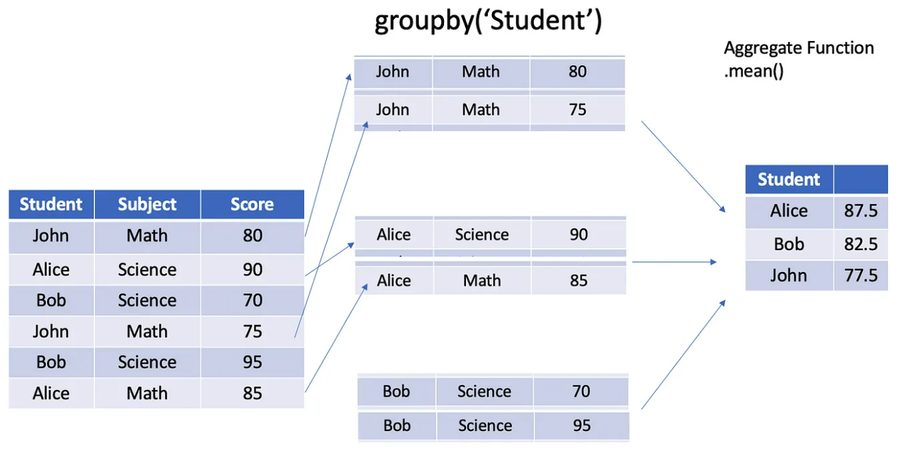
Groupby General Concept

Slide 12

Quiz: How much do you now know about Pandas?
What is Python Pandas?
How is a Pandas DataFrame different than a NumPy array?
Name three unique operations (i.e., methods) you can do with Pandas?
How do you read from or write to a csv file using Pandas?

Slide 13
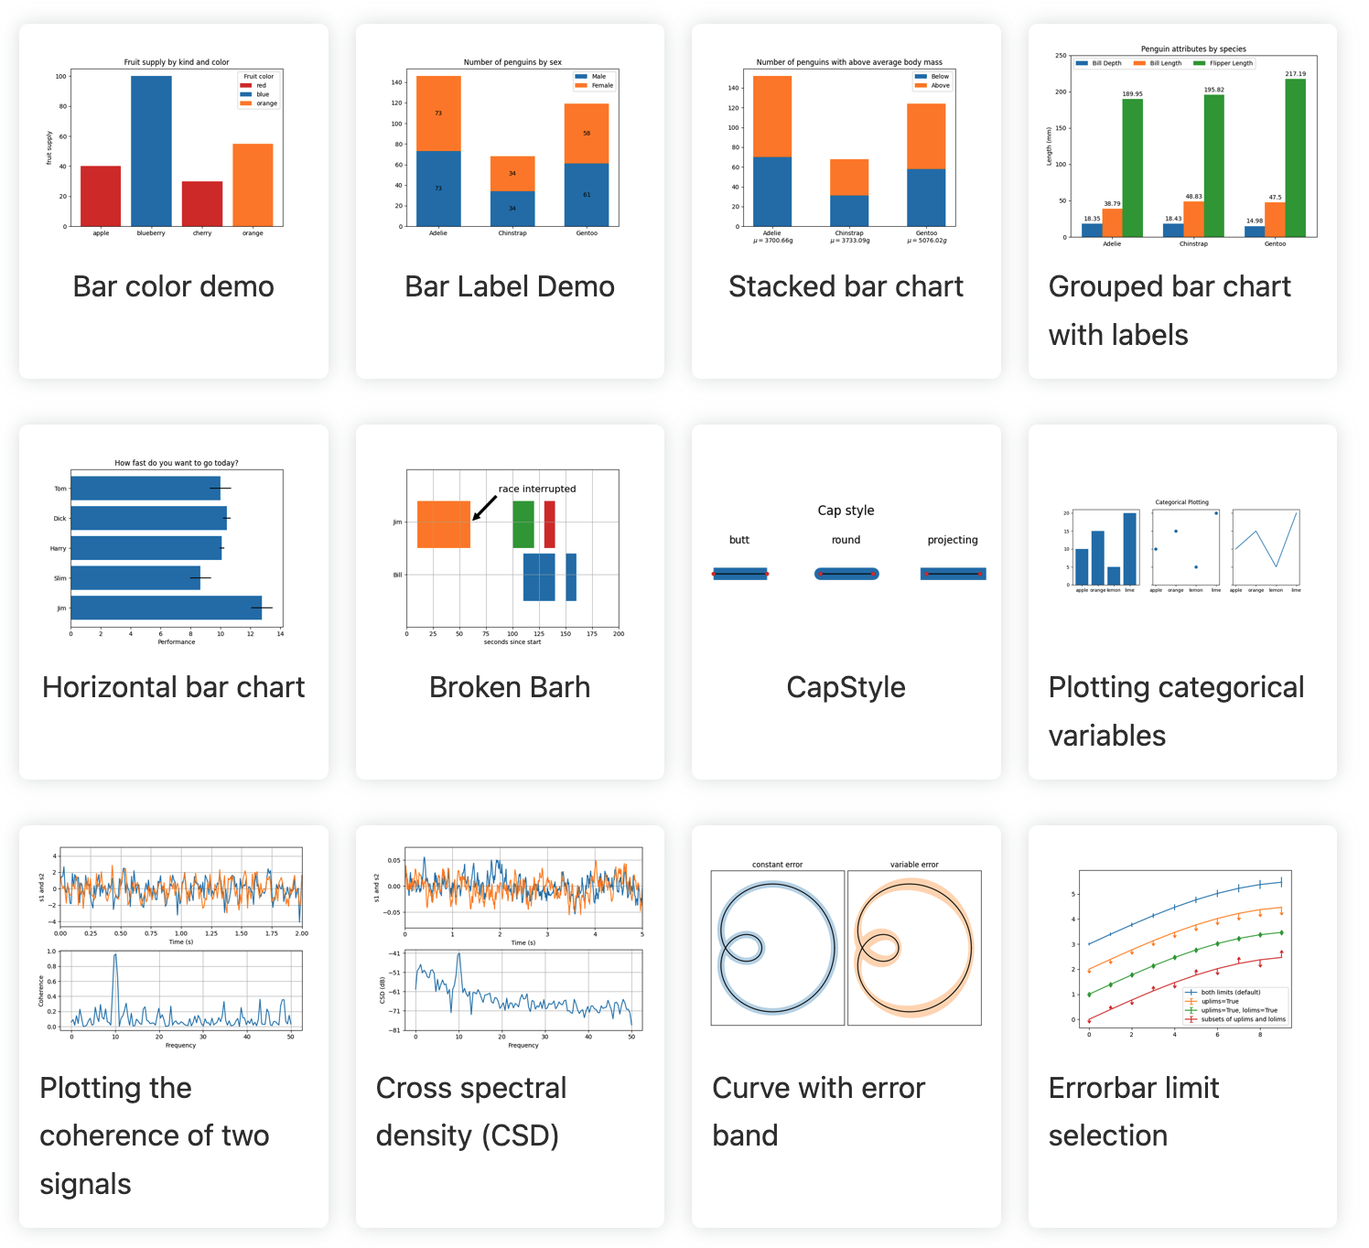
Matplotlib
Matplotlib is a popular Python library used for creating static, animated, and interactive visualizations. Matplotlib can produce a variety of plots, such as:
• Line plots
• Bar charts
• Scatter plots
• Histograms
• Pie charts
• 3D plots
It works closely with other libraries like NumPy for numerical computations and Pandas for handling data structures.

Slide 14
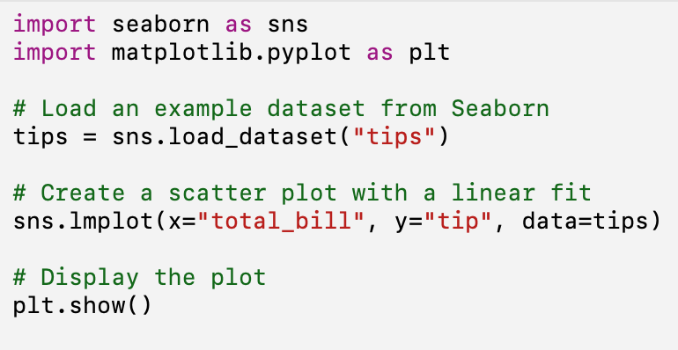
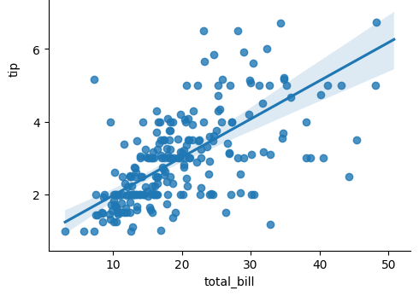
seaborn
Seaborn is a Python data visualization library built on top of Matplotlib, designed to make it easier to create informative and aesthetically pleasing statistical graphics.
Seaborn integrates closely with Pandas data structures, which makes it especially powerful for working with data frames and structured data.
Plot Types: Seaborn supports many types of plots, such as:
Line plots
Bar plots
Scatter plots
Heatmaps
Pair plots (My favorite!)
Box plots
Violin plots

Slide 15
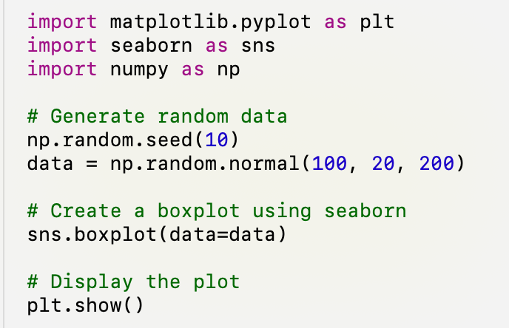
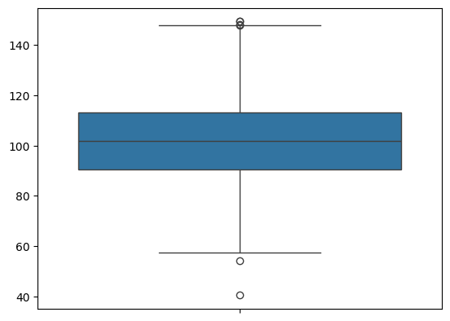
Box and Whisker Plot
A boxplot is a standardized way of displaying the distribution of data based on a five-number summary: minimum, first quartile (Q1), median, third quartile (Q3), and maximum. It helps to show the spread and skewness of the data, highlighting potential outliers.
Key Elements :
1. Box: Spans from Q1 to Q3 (the interquartile range, IQR).
2. Median: A line inside the box showing the middle of the dataset.
3. Whiskers: Lines extending from Q1 to the minimum and Q3 to the maximum values within 1.5 times the IQR.
4. Outliers: Data points that fall outside the whiskers.
By combining these elements, a box plot quickly provides insights into the data’s distribution, variability, and any unusual observations (like outliers).
Notes:
The interquartile range (IQR) is a measure of statistical dispersion, representing the range within which the central 50% of the data points fall. It is calculated by subtracting the first quartile (Q1) from the third quartile (Q3):
\text{IQR} = Q3 - Q1
Where:
• Q1 (First Quartile) is the 25th percentile, meaning 25% of the data is below this value.
• Q3 (Third Quartile) is the 75th percentile, meaning 75% of the data is below this value.
The IQR is useful for identifying the spread of the middle portion of the data, and it helps detect outliers. Data points that fall below Q1 - 1.5 \times \text{IQR} or above Q3 + 1.5 \times \text{IQR} are often considered outliers.

Slide 16
appendix

Slide 17
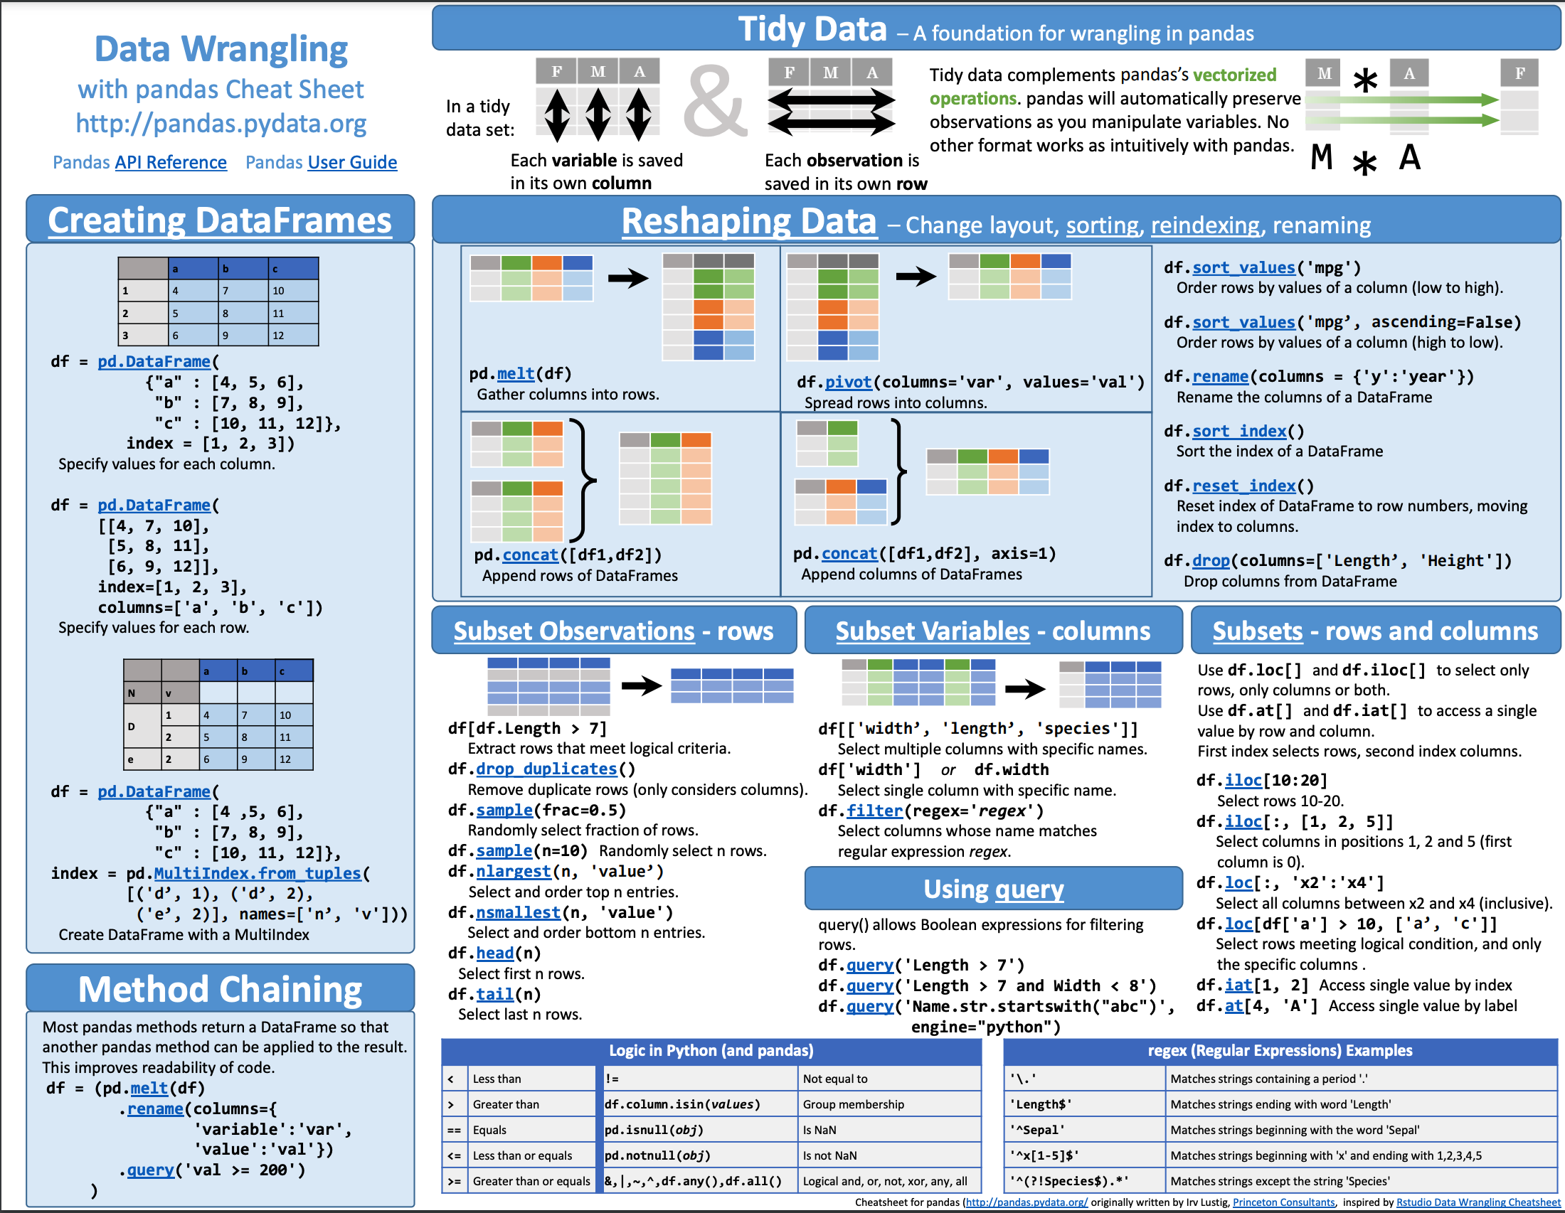
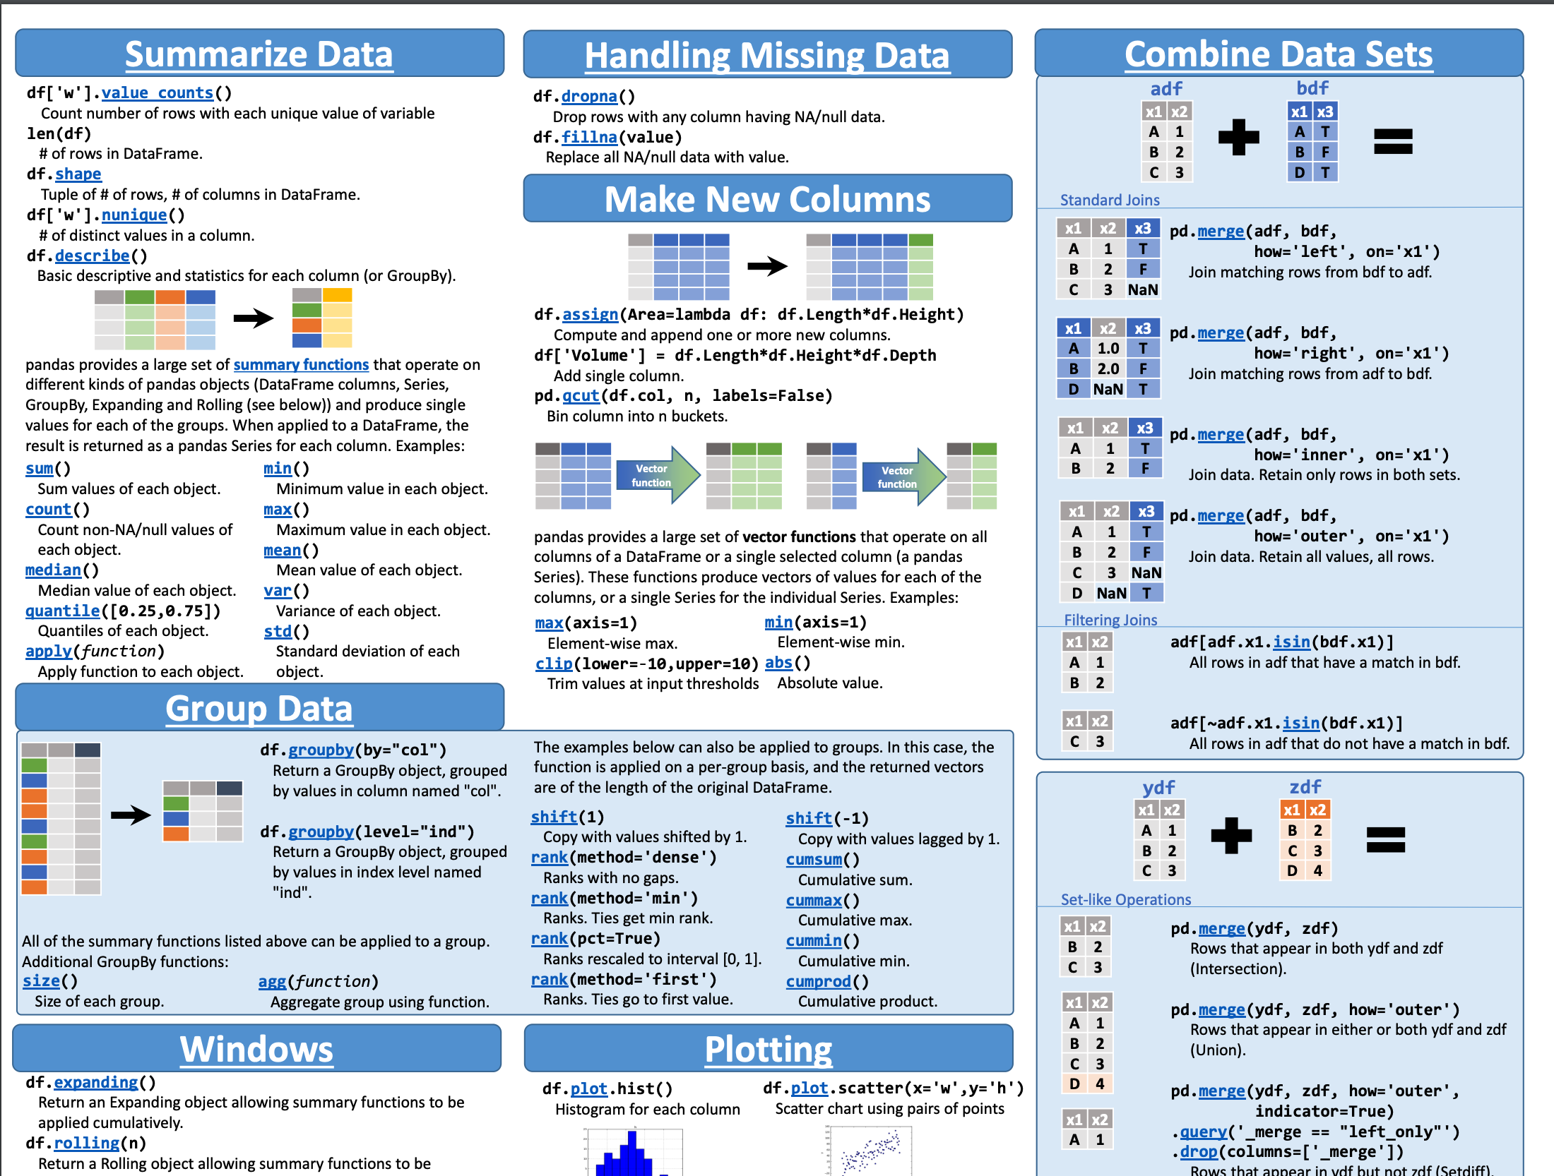
Most commonly used Pandas Operations
https://pandas.pydata.org/Pandas_Cheat_Sheet.pdf
Notes:
https://pandas.pydata.org/Pandas_Cheat_Sheet.pdf

